Slide 1
Analysis of the speeches given by the President of Colombia, Juan M. Santos, from August 2010 to March 2016
Santiago Matallana
03.15.2016

Slide 2
Description and motivation
Methods used
Analysis and results
Further work

Slide 3
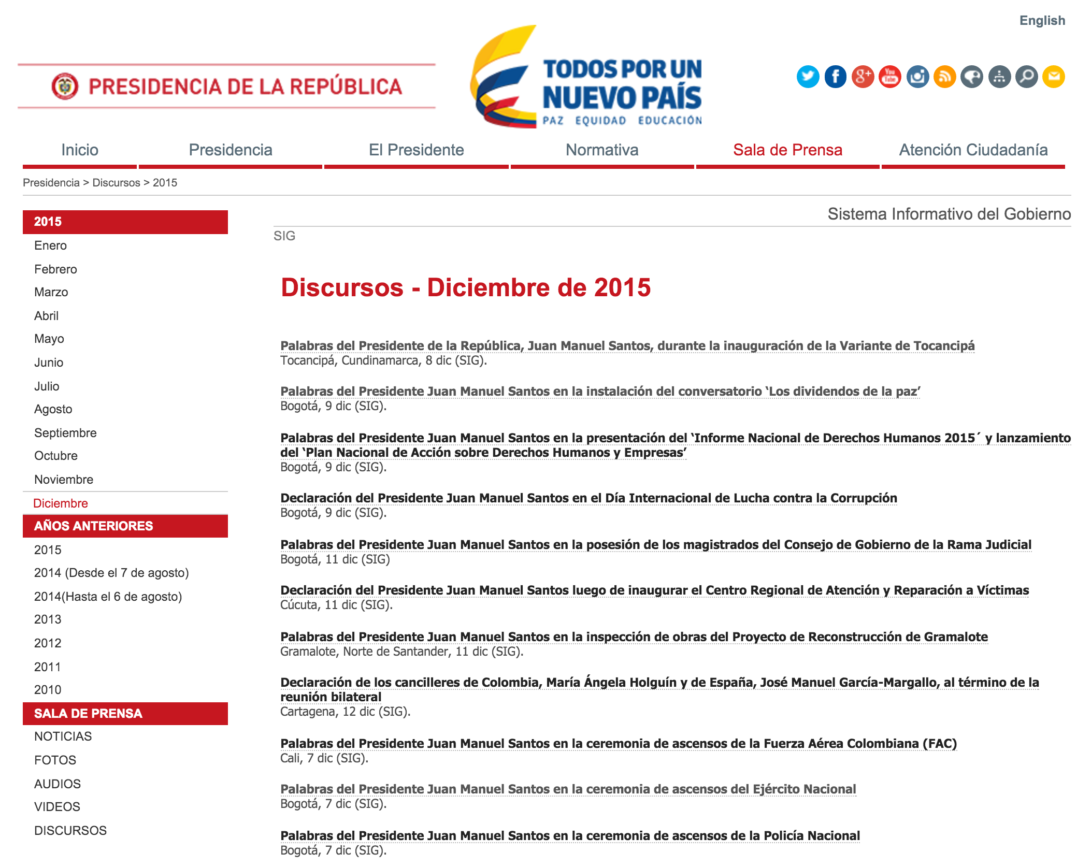
Colombia’s Presidency makes public on its website the interventions/speeches that current President Juan Manuel Santos has given since he came to office in August 2010.
2,600+

Slide 4
President Santos is trying to end a near 50-year-old conflict with left-wing guerilla FARC. There is an ongoing peace process that started in October 2012.

Slide 5
President’s in Colombia can be reelected for one four-year period, for a maximum of eight years in office. President Santos was reelected in mid 2014.

Slide 6
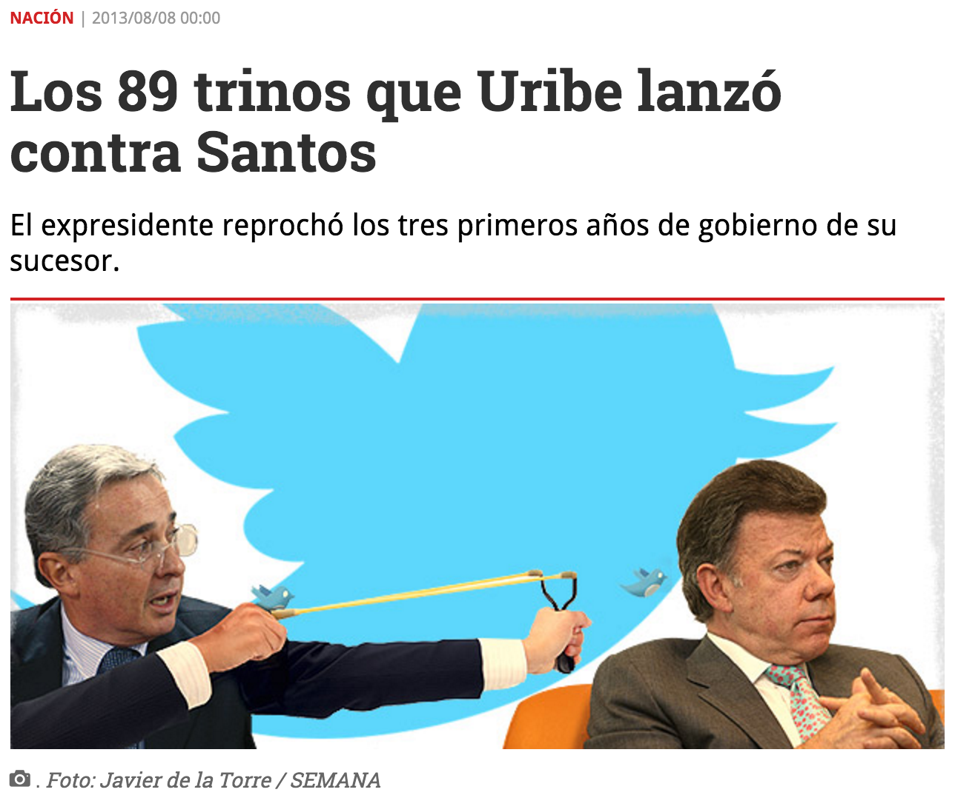
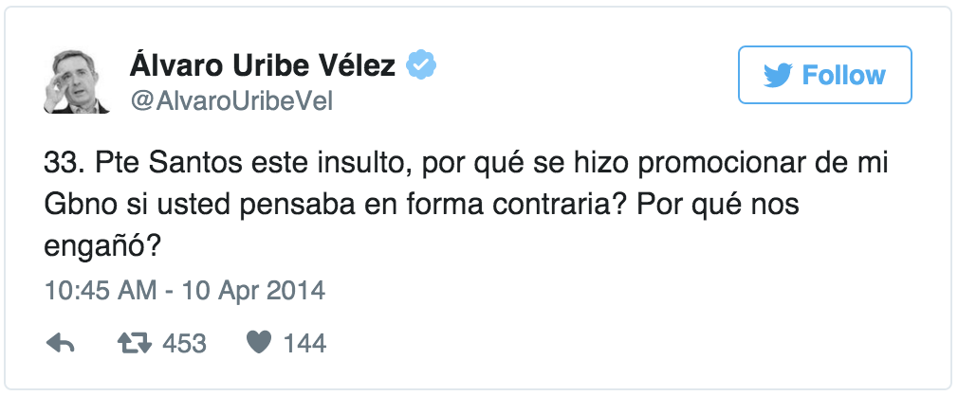
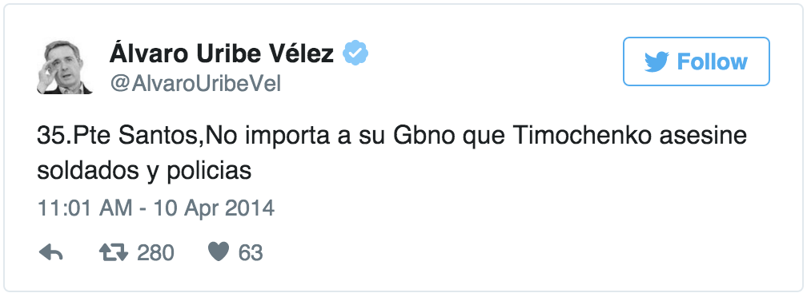
The right-wing opposition, led by Ex-President Alvaro Uribe, has fiercely attacked Santos’ government and the peace process in particular.

Slide 7
What is the relative importance of policy areas, in terms of mentions of key words (e.g. education, health, trade, poverty, innovation, etc.)?

Slide 8
How does the data reflect specific events such us the recent decrease in oil prices, the depreciation of the COP, or the soccer World Cup?

Slide 9
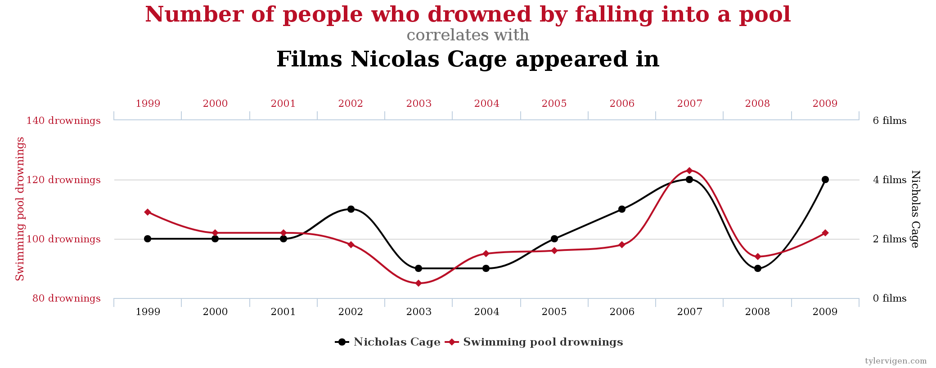
What do basic descriptive statistics of the data tell us about the President's interventions?

Slide 10
Description and motivation
Methods used
Analysis and results
Further work

Slide 11
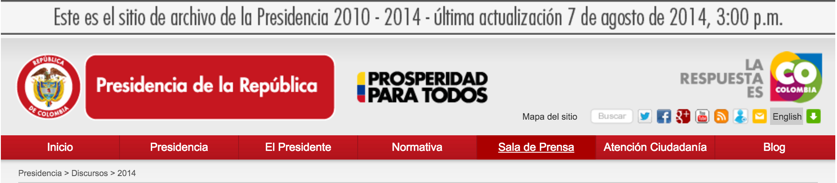
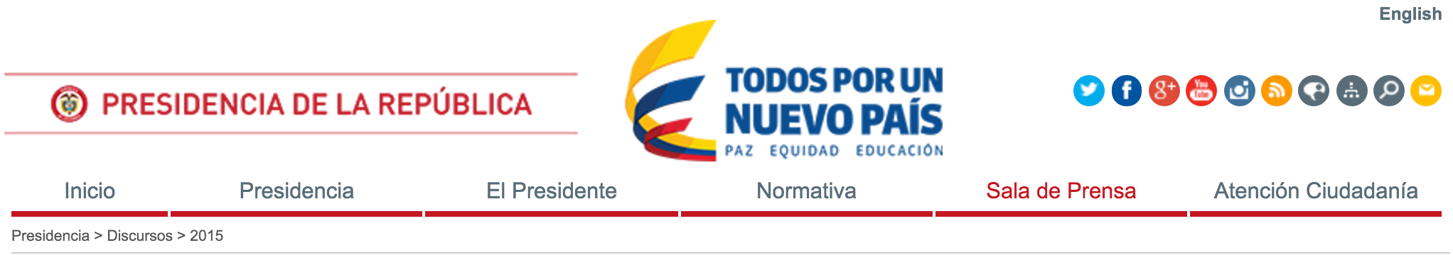
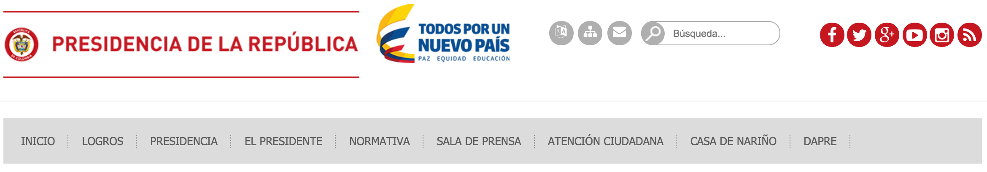
Scraping: requests, BeautifulSoup, selenium (webdriver).
Batch 1: from 08/07/2010 to 08/06/2014 (1,873 speeches)
Batch 2: from 08/07/2014 to 12/12/2015 (678 speeches)
Batch 3: Recent ones –last date of scraping: 03/13/2016– (118 speeches)

Slide 12
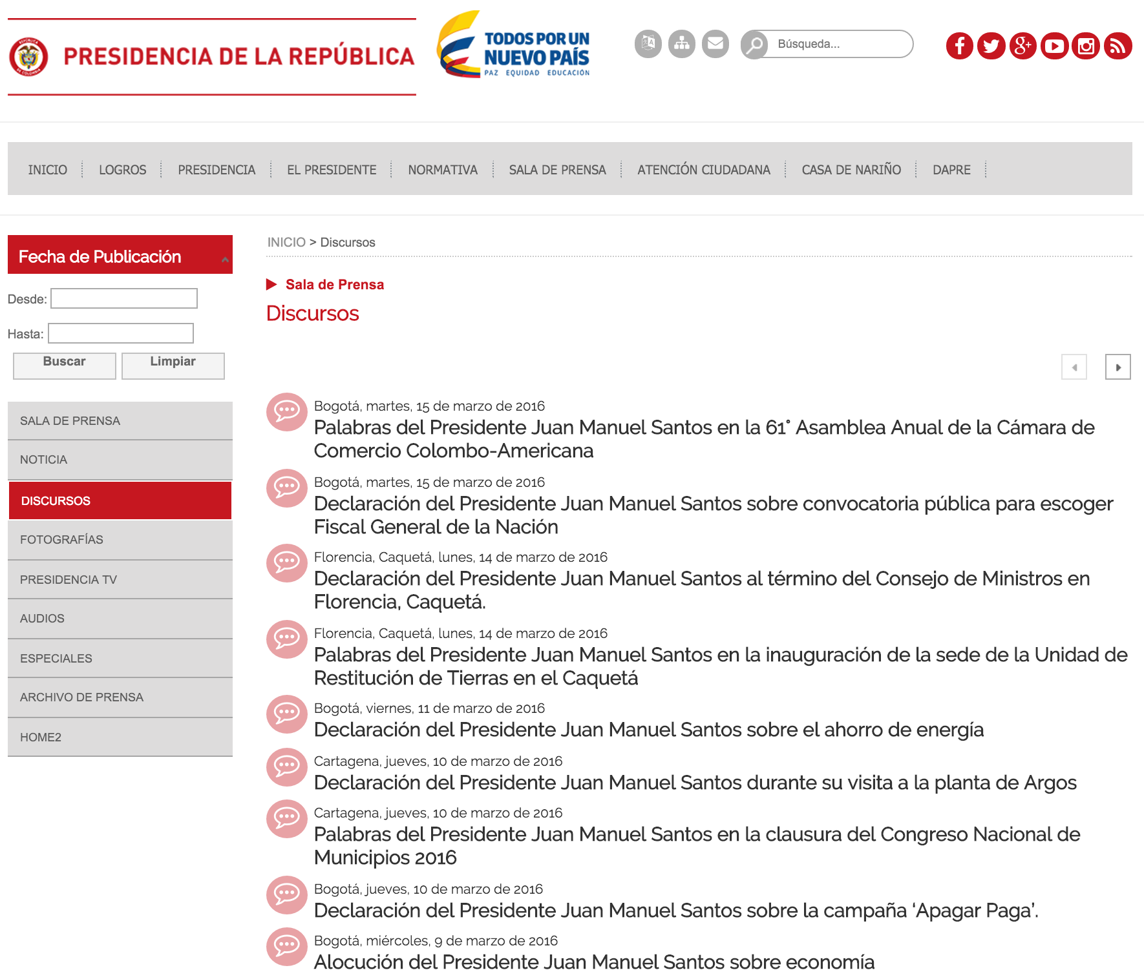

Slide 13
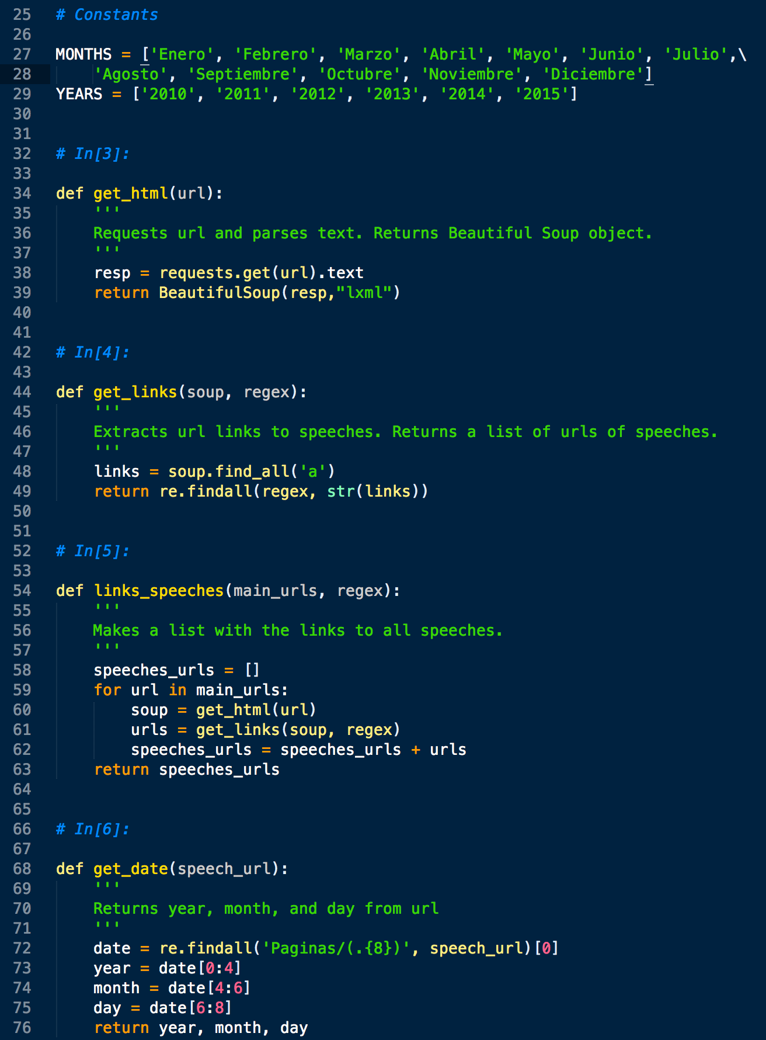
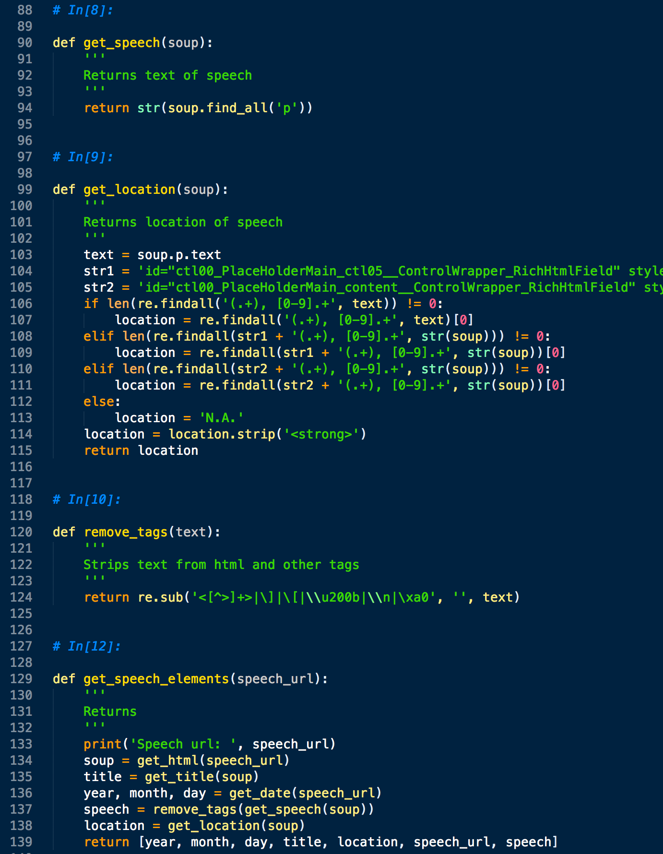
Both to scrape the raw text and to extract the data from it, I wrote helper functions to get all the elements of a speech into a structured object.

Slide 14
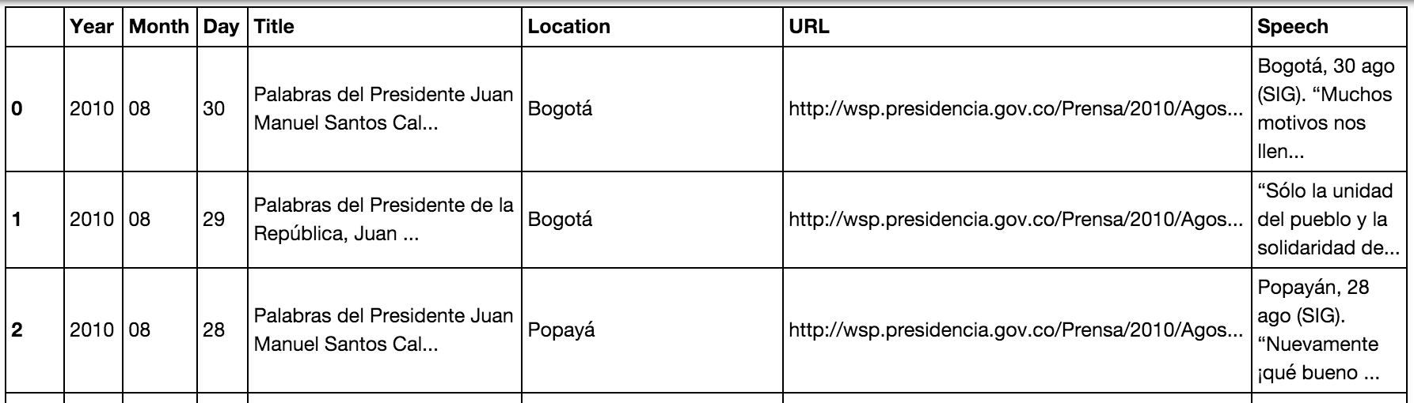
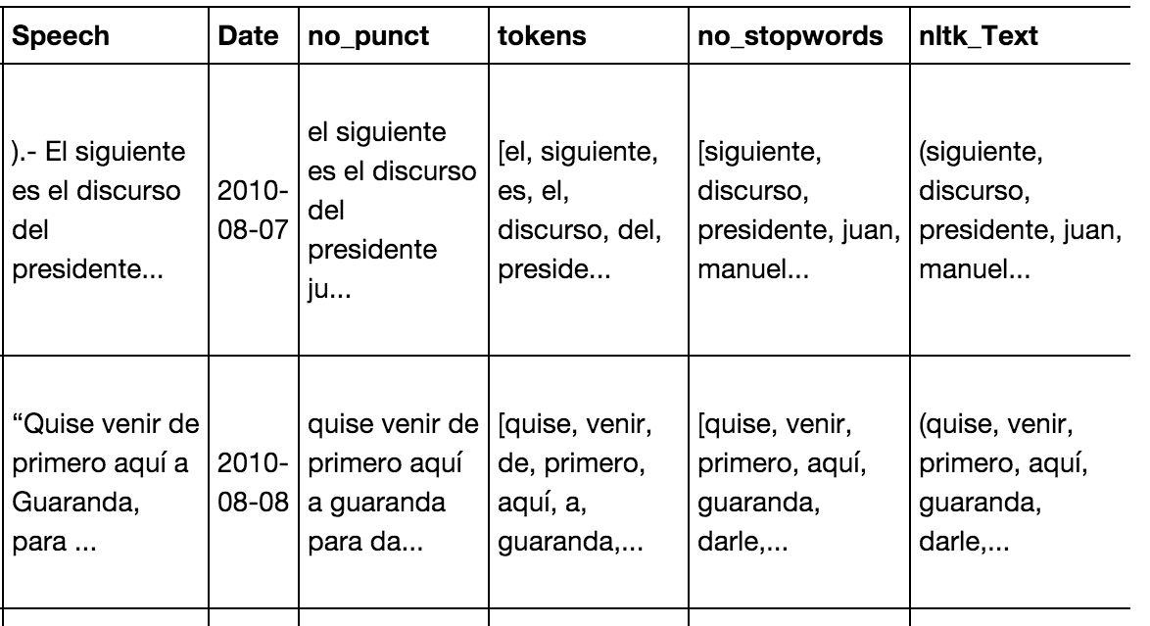
Managed data in a Pandas data frame, stored in pickle file. Consolidated the three data frames into one and furthered cleaned the data using 'Pandas' methods, 'string' methods, and regular expressions.
Using 'string' and 'nltk' libraries, stripped speeches from punctuation, converted to lowercase, tokenized text, dropped stopwords (in Spanish), etc.

Slide 15
Description and motivation
Methods used
Analysis and results
Further work

Slide 16
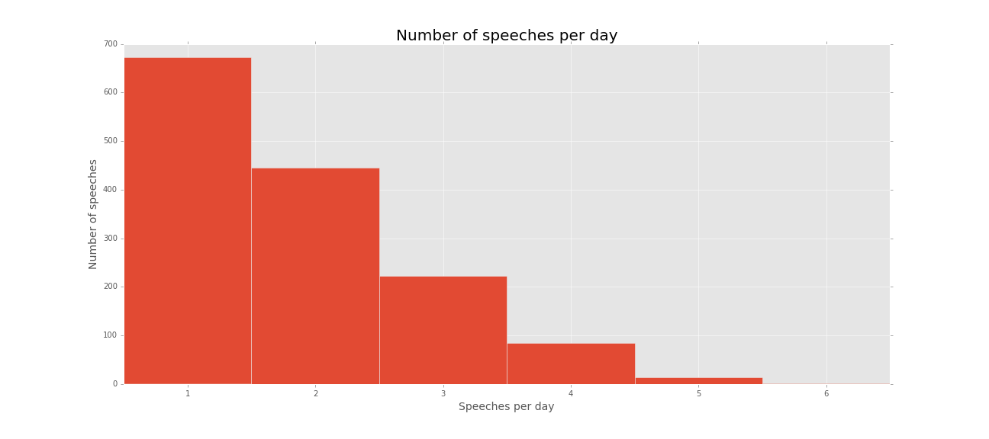
Some basics…
2,651 speeches | 2,041 days in office | 1,442 days with interventions | max daily: 6

Slide 17
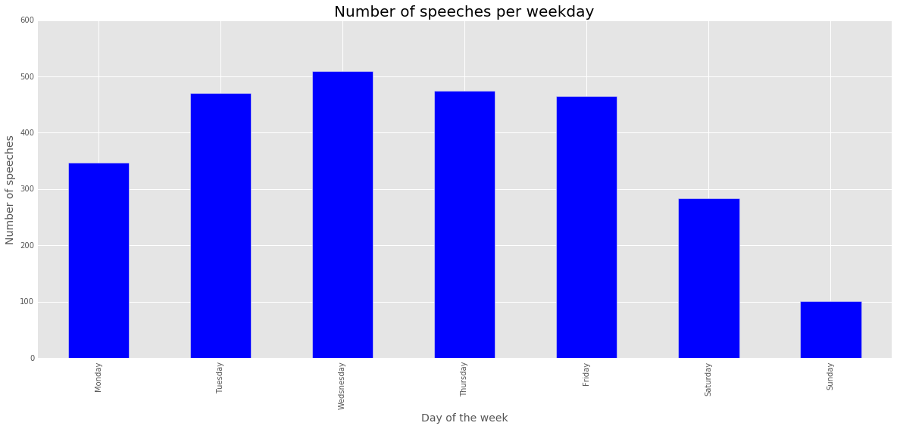

Slide 18
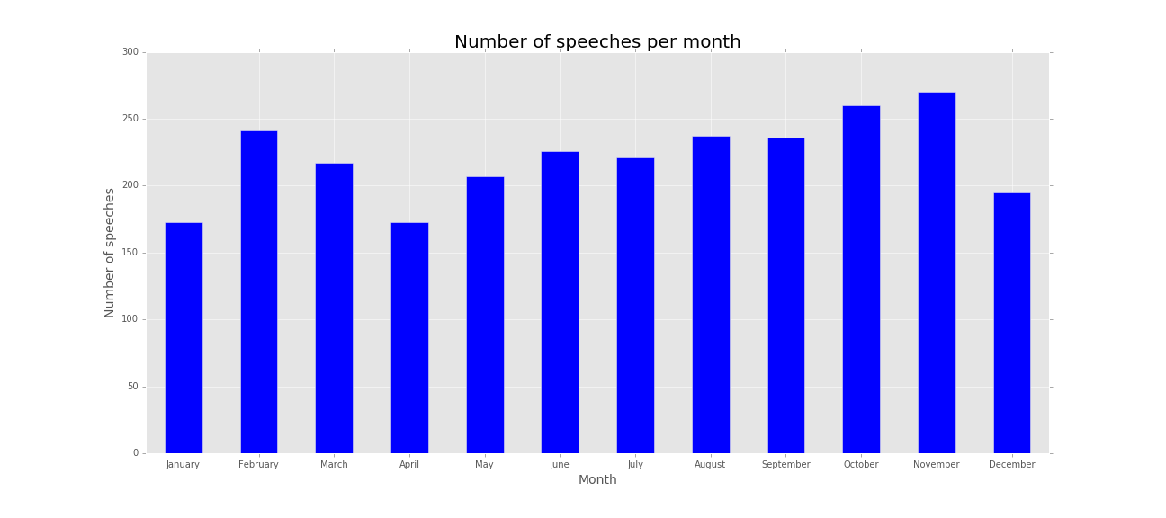

Slide 19
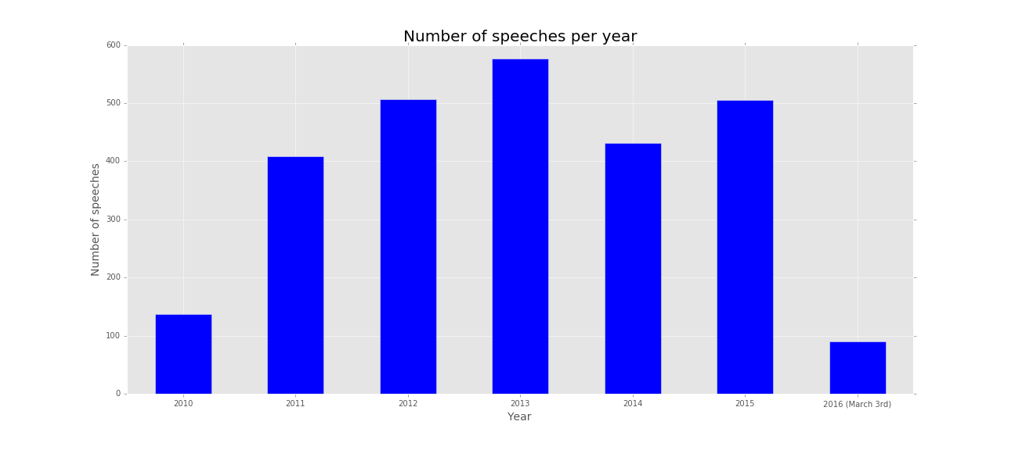

Slide 20
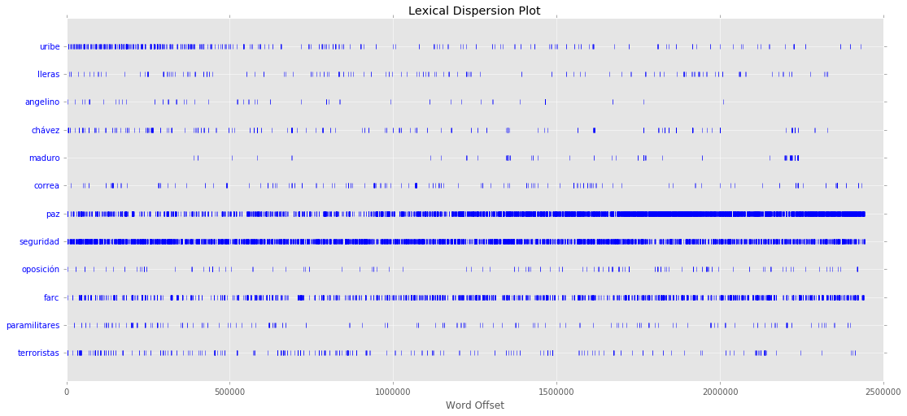
Lexical Dispersion plots…

Slide 21
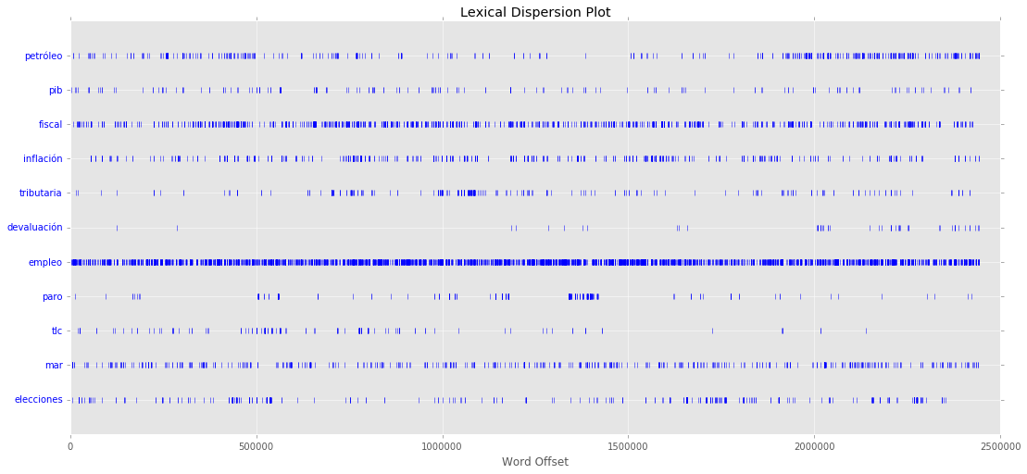

Slide 22
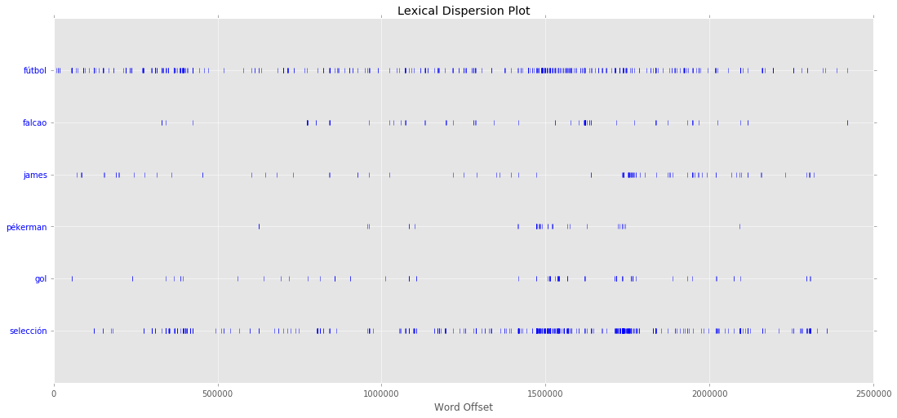

Slide 23
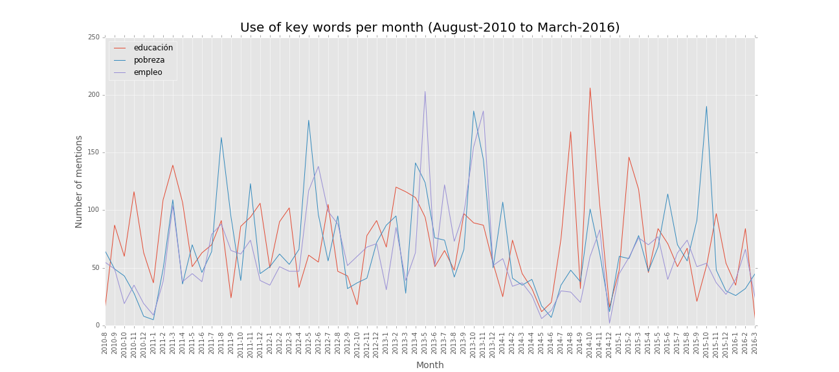
Policy areas…

Slide 24
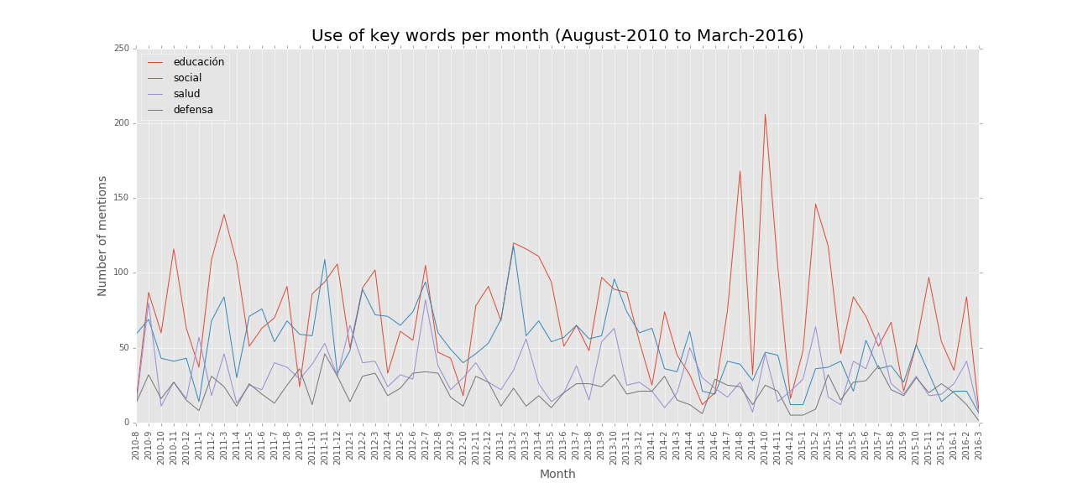

Slide 25
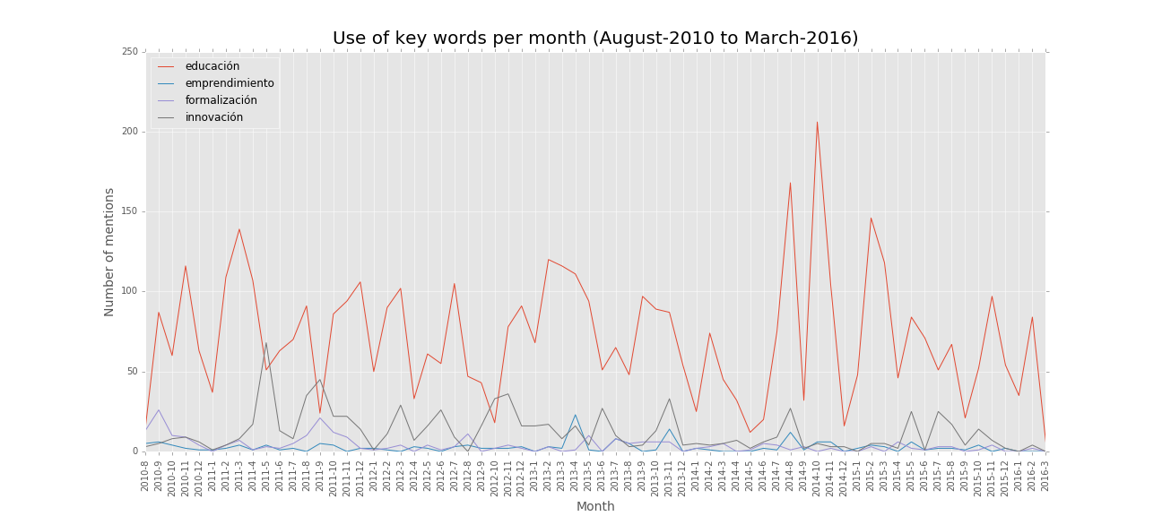

Slide 26


Slide 27
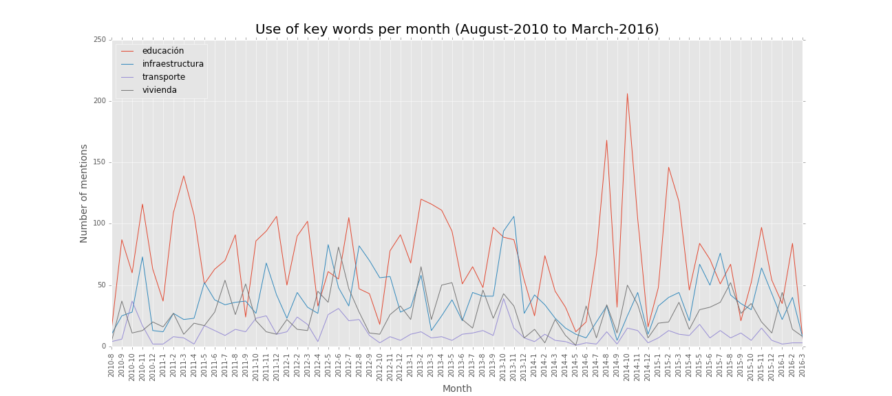

Slide 28
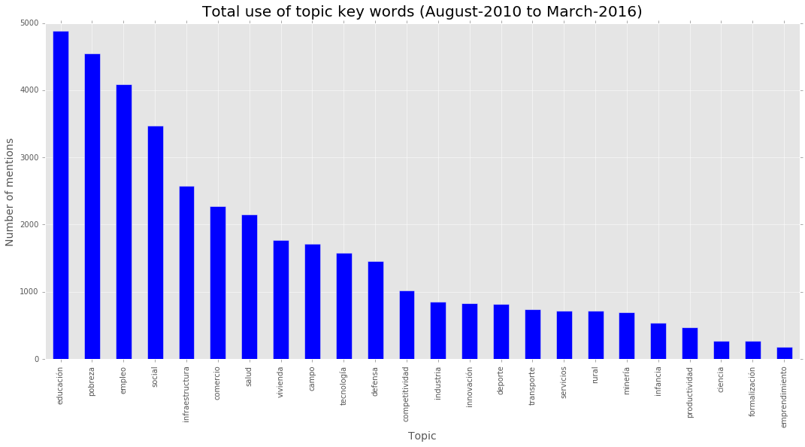

Slide 29
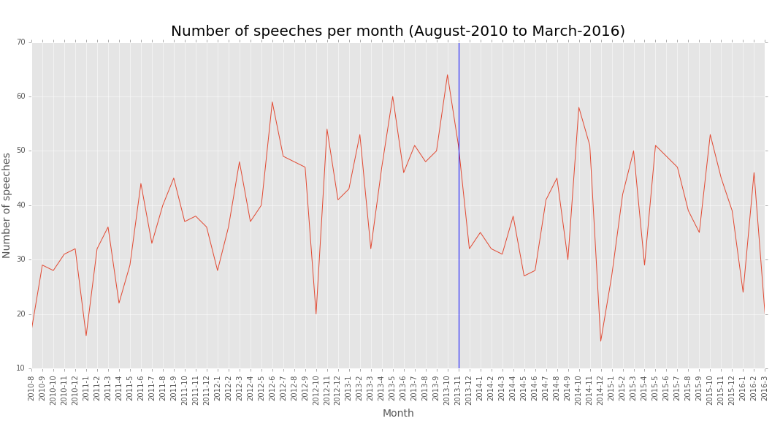
Number of speeches and political cycle…
The vertical blue line indicates the month in which the Law of Electoral Guarantees was enacted.

Slide 30
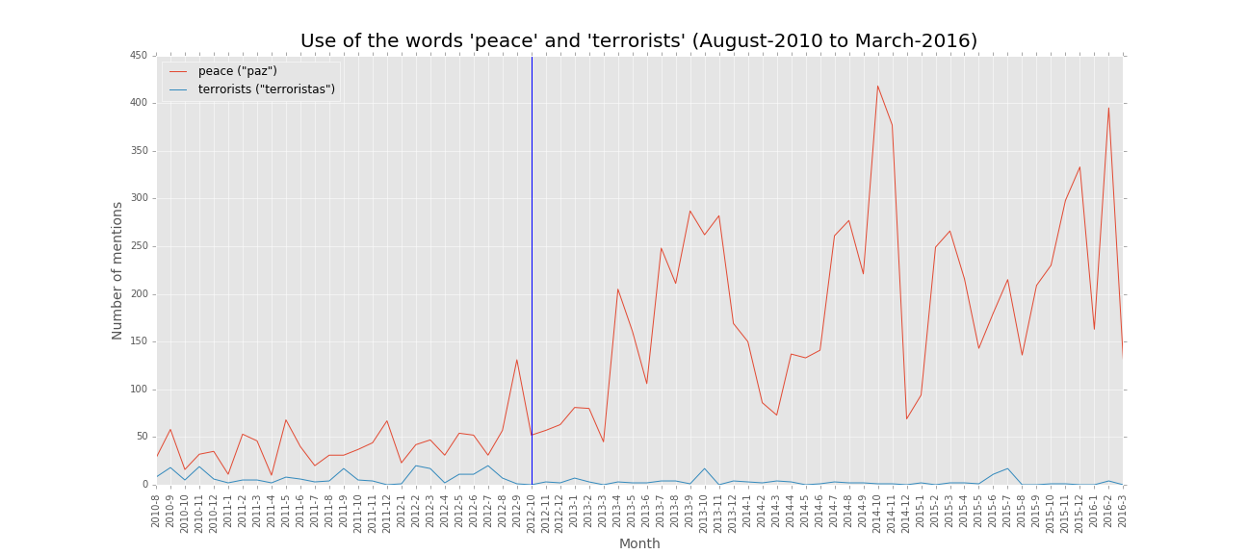
Peace talks and the use of the word “peace” in time…
The vertical blue line indicates the official start of peace talks with FARC.

Slide 31
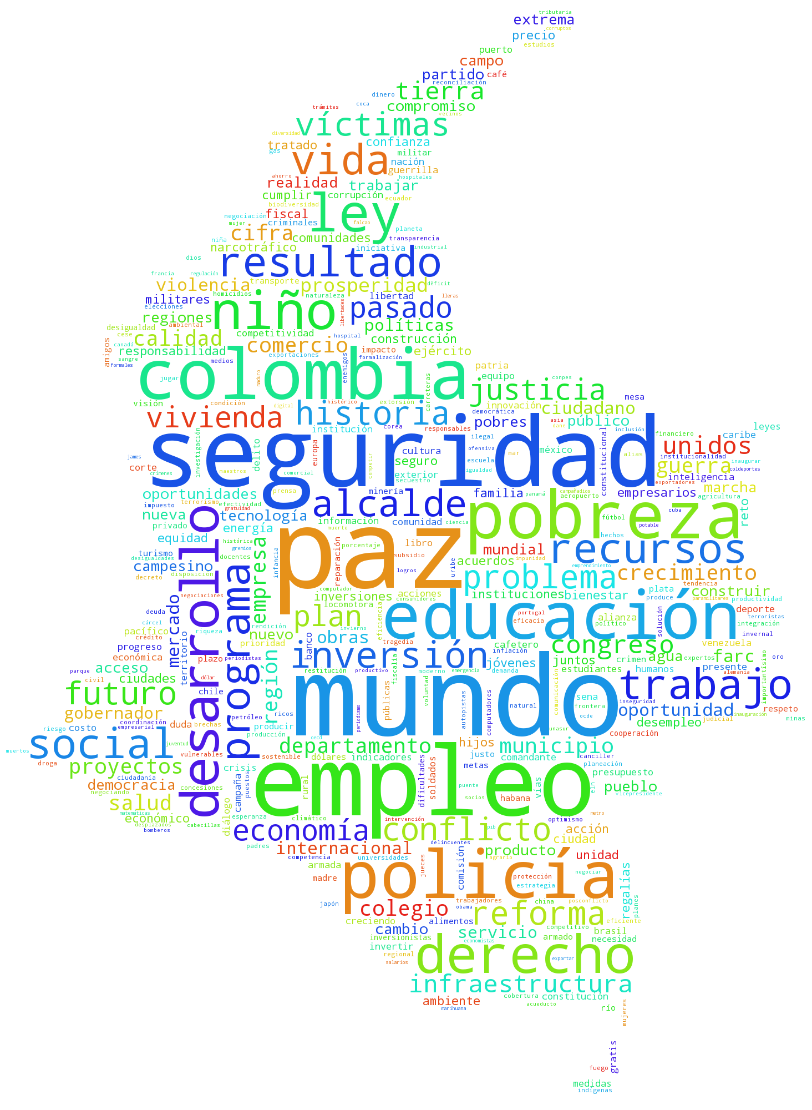
Never so proud…

Slide 32
Description and motivation
Methods used
Analysis and results
Further work

Slide 33
Thank you!
Santiago Matallana
03.15.2016

